Slide 1
Graph Representation Learning for Drug Discovery
Jian Tang
Mila-Quebec AI Institute
CIFAR AI Research Chair
HEC Montreal
www.jian-tang.com

Slide 2
Drug Discovery is a Long and Expensive Process
It takes more than 10 years and $2.5B to develop a new drug.
Figure from Gaudelet et al.

Slide 3
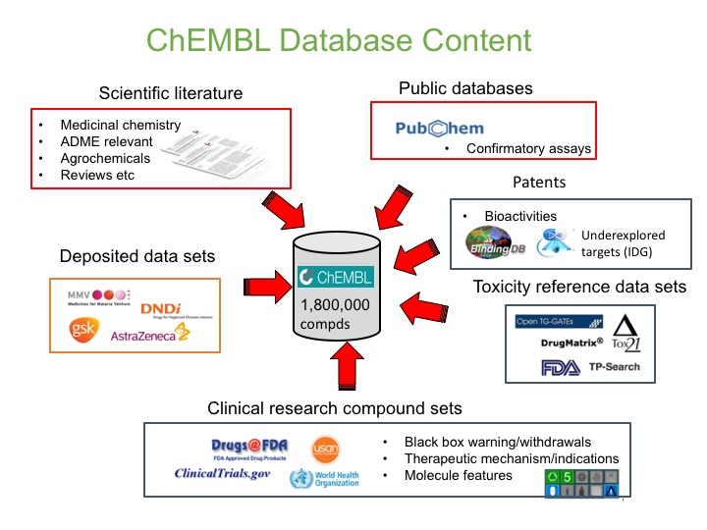
Big Opportunity for Artificial Intelligence
A huge amount of data is generated in the biomedical domain

Slide 4
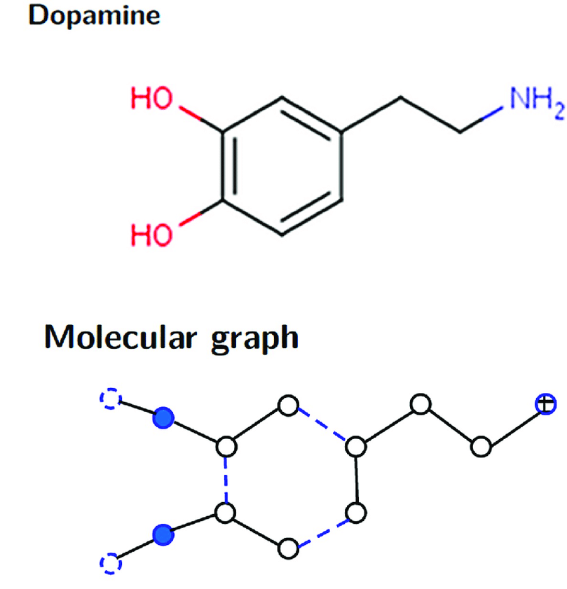
Many Data are Graph-Structured
Figure from
Zeng et al. 2019
Figure from
Gaudelet et al.
Fig. 1: Small Molecules
Fig. 2: Proteins
Fig. 3: Biomedical Knowledge Graphs

Slide 5
Research Problems (1): De Novo Drug Discovery
Molecule Property Prediction
Property
De Novo Molecule Design and
Optimization
Property
Retrosynthesis Prediction
+

Slide 6
Research Problems (2): Drug Repurposing
Predict the links between drugs and
diseases on biomedical knowledge graphs
Reasoning on biomedical knowledge graphs
Fig. 3: Biomedical Knowledge Graphs

Slide 7
Research Problems (1): De Novo Drug Discovery
Molecule Property Prediction
Property
De Novo Molecule Design and
Optimization
Property
Retrosynthesis Prediction
+

Slide 8
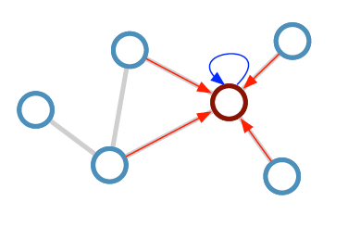
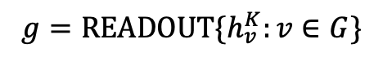
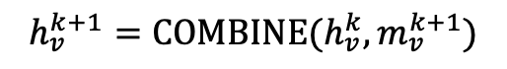
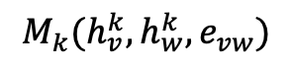
Graph Neural Networks
Techniques for learning node/graph representations
Graph convolutional Networks (Kipf et al. 2016)
Graph attention networks (Veličković et al. 2017)
Neural Message Passing (Gilmer et al. 2017)
MESSAGE PASSING:
$$M_{k}(h_{v}^{k}, h_{w}^{k}, e_{vw})$$
w
AGGREGATE :
$$m_{v}^{k+1}=AGGREGATE\{M_{k}\left(h_{v}^{k}, h_{w}^{k}, e_{vw}\right):w∈N\left(v\right)\}$$
v
COMBINE :
$$h_{v}^{k+1}=COMBINE(h_{v}^{k},m_{v}^{k+1})$$
READOUT:
$${g=READOUT\{h}_{v}^{K}:v∈G\}$$

Slide 9
InfoGraph: Unsupervised and Semi-supervised Whole-Graph Representation Learning (Sun et al. ICLR’20)
For supervised methods based on graph neural networks, a large number of labeled data are required for training
The number of labeled data are very limited in drug discovery
A large amount of unlabeled data (molecules) are available
This work: how to effectively learn whole graph representations in unsupervised or semi-supervised fashion
Fanyun Sun, Jordan Hoffman, Vikas Verma and Jian Tang. InfoGraph: Unsupervised and Semi-supervised Graph-Level Representation Learning via Mutual Information Maximization. ICLR’20.

Slide 10
InfoGraph: Unsupervised Whole-Graph Representation Learning (Sun et al. ICLR’20)
Maximizing the mutual information between the whole graph representation and all the sub-structure representation .
Ensure the graph representation capture the predominant information among all the substructures
K-layer graph neural networks:
Summarize the local structure information at every node i:
Summarize the information of the whole graph:
Fanyun Sun, Jordan Hoffman, Vikas Verma and Jian Tang. InfoGraph: Unsupervised and Semi-supervised Graph-Level Representation Learning via Mutual Information Maximization. ICLR’20.

Slide 11
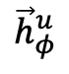
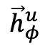
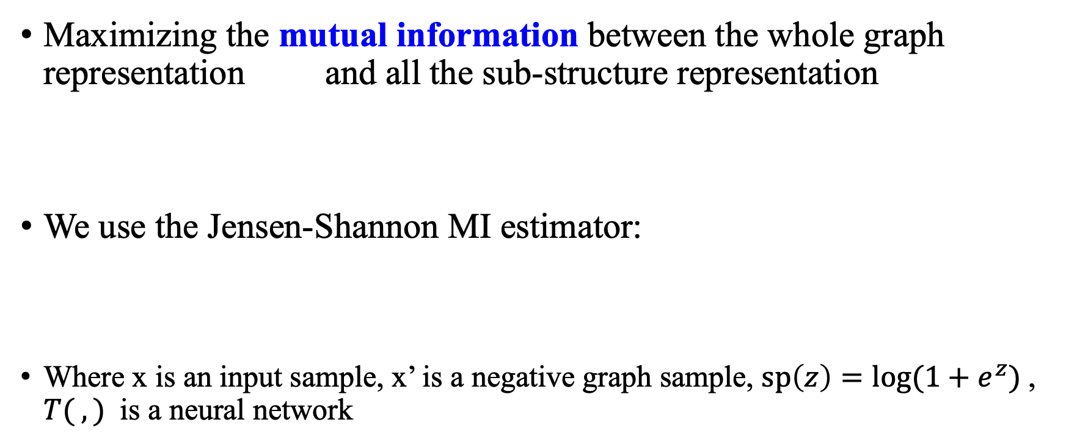
InfoGraph: Unsupervised Whole-Graph Representation Learning
Maximizing the mutual information between the whole graph representation and all the sub-structure representation
We use the Jensen-Shannon MI estimator:
Where x is an input sample, x’ is a negative graph sample, $sp\left(z\right)=\log{(1+e^{z})}$, $T( , )$ is a neural network
$${\vec{h}}_{φ}^{u}$$
$${\vec{h}}_{φ}^{u}$$

Slide 12
InfoGraph*: Semi-supervised Graph Representation Learning
Two different encoders for the supervised and unsupervised tasks
Maximize the mutual information of the representations learned by the two encoders at all levels (or layers)

Slide 13
Results on Graph Classification and Regression
Table 1: Graph classification accuracy
with unsupervised methods
Table 2: Results of semi-supervised experiments on QM9 data set.

Slide 14
Research Problems (1): De Novo Drug Discovery
Molecule Property Prediction
Property
De Novo Molecule Design and
Optimization
Property
Retrosynthesis Prediction
+

Slide 15
GraphAF: an Autoregressive Flow for Molecular Graph Generation (Shi & Xu ICLR’20)
Formulate graph generation as a sequential decision process
In each step, generate a new atom
Determine the bonds between the new atoms and existing atoms
Chence Shi, Minkai Xu, Zhaocheng Zhu, Weinan Zhang, Ming Zhang, and Jian Tang.
”GraphAF: a Flow-based Autoregressive Model for Molecular Graph Generation.” ICLR’20.

Slide 16
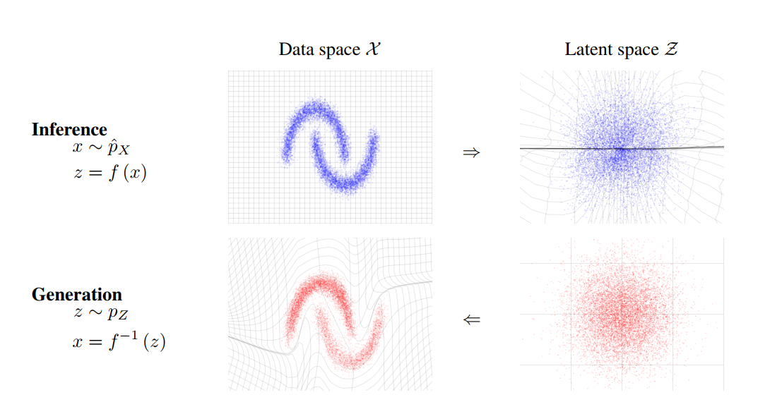
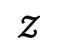
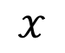
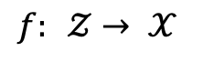
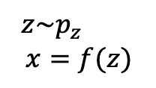
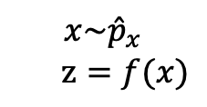
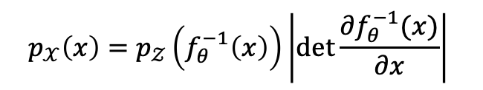
Normalizing Flows (Dinh et al. 2016)
Defines an invertible mapping from a base distribution (e.g. Gaussian Distribution) to observation space
$$f: 𝒵→ 𝒳$$
Data space
$$𝒳$$
Latent space
$$𝒵$$
Inference
$$x\sim {\hat{p}}_{x}$$
$z=f(x)$
Change-of-Variables
$$p_{𝒳}\left(x\right)=p_{𝒵}\left(f_{θ}^{−1}\left(x\right)\right)\left|\det{\frac{∂f_{θ}^{−1}(x)}{∂x}}\right|$$
Generation
$z\sim p_{z}$
$$x=f(z)$$
Density estimation using Real NVP (2016)

Slide 17
GraphAF: an Autoregressive Flow for Molecular Graph Generation
Traverse a graph through BFS-order
Transform each graph into a sequence of nodes and edges
Defines an invertible mapping from a base distribution (Gaussian distribution) to the observations ( graph nodes and edge sequences)

Slide 18
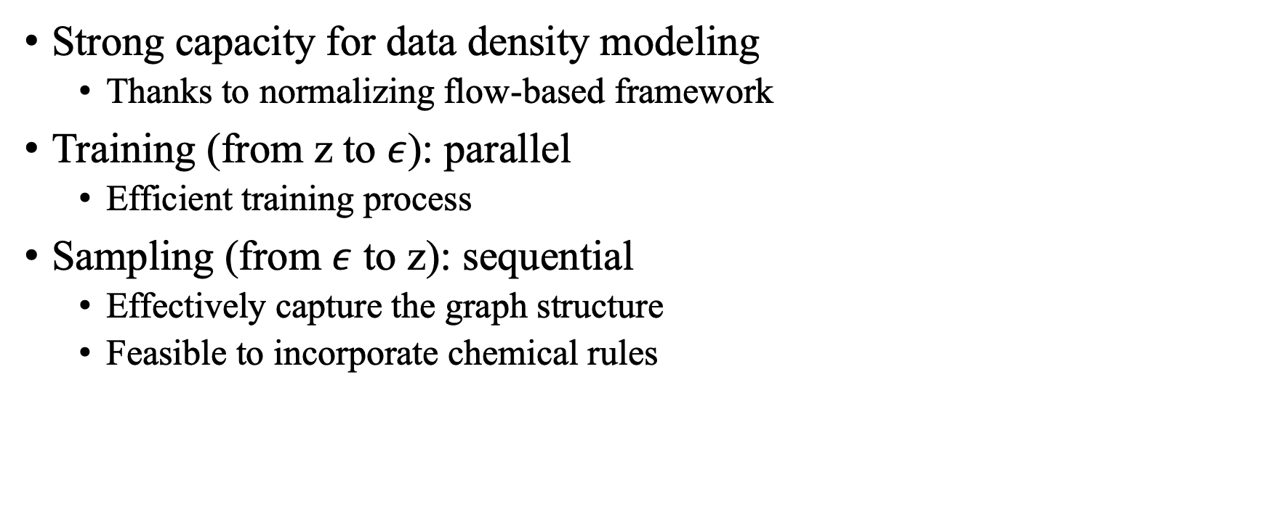
Advantages of GraphAF
Strong capacity for data density modeling
Thanks to normalizing flow-based framework
Training (from z to $ε$): parallel
Efficient training process
Sampling (from $ε$ to z): sequential
Effectively capture the graph structure
Feasible to incorporate chemical rules

Slide 19
Molecule Generation
Training Data: ZINC250K
250K drug-like molecules with a maximum atom number of 38
9 atom types and 3 edge types

Slide 21
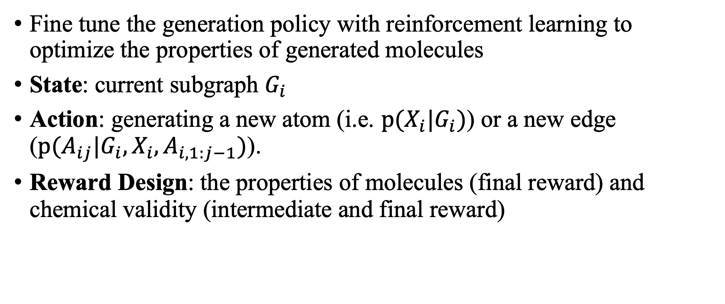
Goal-Directed Molecule Generation with Reinforcement Learning
Fine tune the generation policy with reinforcement learning to optimize the properties of generated molecules
State: current subgraph $G_{i}$
Action: generating a new atom (i.e. $p(X_{i}|G_{i})$) or a new edge ($p(A_{ij}|G_{i}, X_{i}, A_{i, 1:j−1})$).
Reward Design: the properties of molecules (final reward) and chemical validity (intermediate and final reward)

Slide 22
Molecule Optimization
Properties
Penalized logP
QED (druglikeness)

Slide 23
Constrained Optimization

Slide 24
Research Problems (1): De Novo Drug Discovery
Molecule Property Prediction
Property
De Novo Molecule Design and
Optimization
Property
Retrosynthesis Prediction
+

Slide 25
Retrosynthesis Prediction
Once a molecular structure is designed, how to synthesize it?
Retrosynthesis planning/prediction
Identify a set of reactants to synthesize a target molecule
…
Predict Reactants
Reactant A
Reaction Type
(optional)
…
Product (Given)
Reactant B

Slide 26
A Graph to Graphs Framework for Retrosynthesis Prediction (Shi et al. 2020)
Each molecule is represented as a molecular graph
Formulate the problem as a graph (product molecule) to a set of graphs (reactants)
The whole framework are divided into two stages
Reaction center identification
Graph Translation
Chence Shi, Minkai Xu, Hongyu Guo, Ming Zhang and Jian Tang. A Graph to Graphs Framework for Retrosynthesis Prediction.
ICML, 2020.

Slide 27
The G2Gs Framework (Shi et al. 2020)
Reaction
Center Identification
Break to
Synthons
+
CI
Variational Graph Translation
C
+
O
B
Shi et al., 2020, A Graph to Graphs Framework for Retrosynthesis Prediction

Slide 28
Research Problems (2): Drug Repurposing
Predict the links between drugs and
diseases on biomedical knowledge graphs
Reasoning on biomedical knowledge graphs
Fig. 3: Biomedical Knowledge Graphs

Slide 29
Reasoning on Knowledge Graphs
Reasoning in continuous space---knowledge graph embedding-based methods: RotatE (Sun et al. ICLR’ 2019)
Symbolic logic reasoning: pLogicNet (Qu et al. NeurIPS’2019)
Learning logic rules for reasoning on knowledge graphs: RNNLogic (Qu et al. ICLR’2021)
Sun, Zhiqing, Zhihong Deng, Jian-Yun Nie, and Jian Tang et al. "Rotate: Knowledge graph embedding by relational rotation in complex space." ICLR’2019.
Qu, Meng, and Jian Tang. "Probabilistic logic neural networks for reasoning." Advances in Neural Information Processing Systems. 2019.
Qu, Meng*, Chen, Junkun*, Xhonneux Louis-Pascal, Bengio Yoshua, and Tang, Jian. "RNNLogic: Learning Logic Rules for Reasoning on Knowledge Graphs." ICLR’2021.

Slide 30
Next Step: Going Beyond 2D Graphs to 3D Structures
A more natural and intrinsic representations of molecules: 3D conformations
Determines its biological and physical activities
E.g., charge distribution, steric constraints, and interaction with other molecules
C1CO
1D SMILES
2D Graph
3D Conformation

Slide 31
Conformation Prediction
For most molecules, their 3D structure are not available
How to predict valid and stable conformations?
Each atom is represented as its 3D coordinates

Slide 32
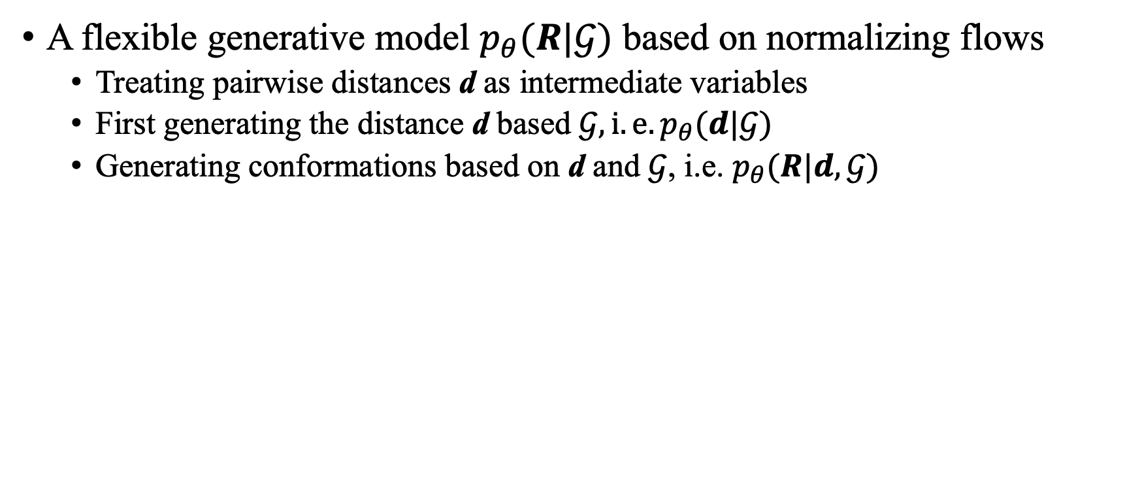
Our Solution (Xu and Luo et al. 2020)
A flexible generative model $p_{θ}(R|𝒢)$ based on normalizing flows
Treating pairwise distances d as intermediate variables
First generating the distance d based $𝒢, i.e.p_{θ}(d|𝒢)$
Generating conformations based on d and $𝒢$, i.e. $p_{θ}(R|d, 𝒢)$
Minkai Xu*, Shitong Luo*, Yoshua Bengio, Jian Peng, Jian Tang. Learning Neural Generative Dynamics for Molecular Conformation Generation. ICLR’21.

Slide 33
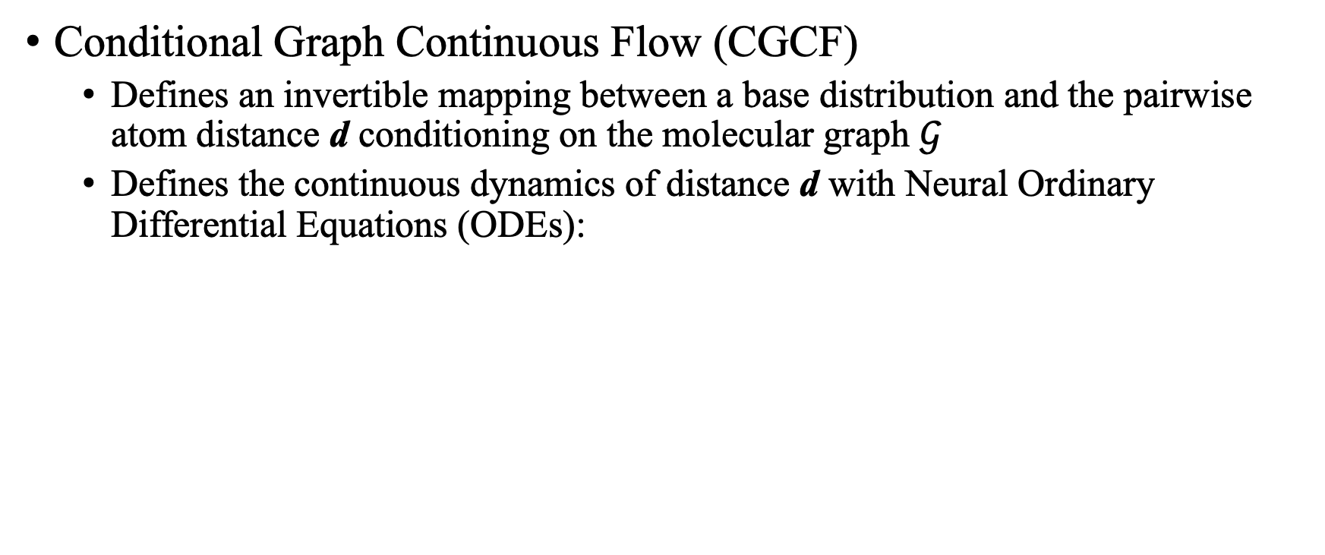
Distance Geometry Generation
Conditional Graph Continuous Flow (CGCF)
Defines an invertible mapping between a base distribution and the pairwise atom distance d conditioning on the molecular graph $𝒢$
Defines the continuous dynamics of distance d with Neural Ordinary Differential Equations (ODEs):
Graph Neural Networks

Slide 34
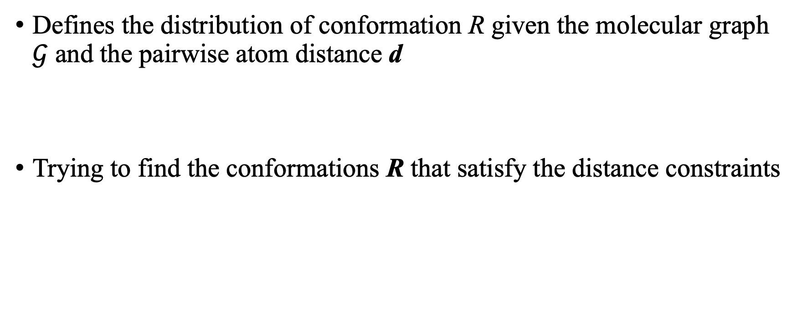
Conformation Prediction
Defines the distribution of conformation R given the molecular graph $𝒢$ and the pairwise atom distance d
Trying to find the conformations R that satisfy the distance constraints

Slide 35

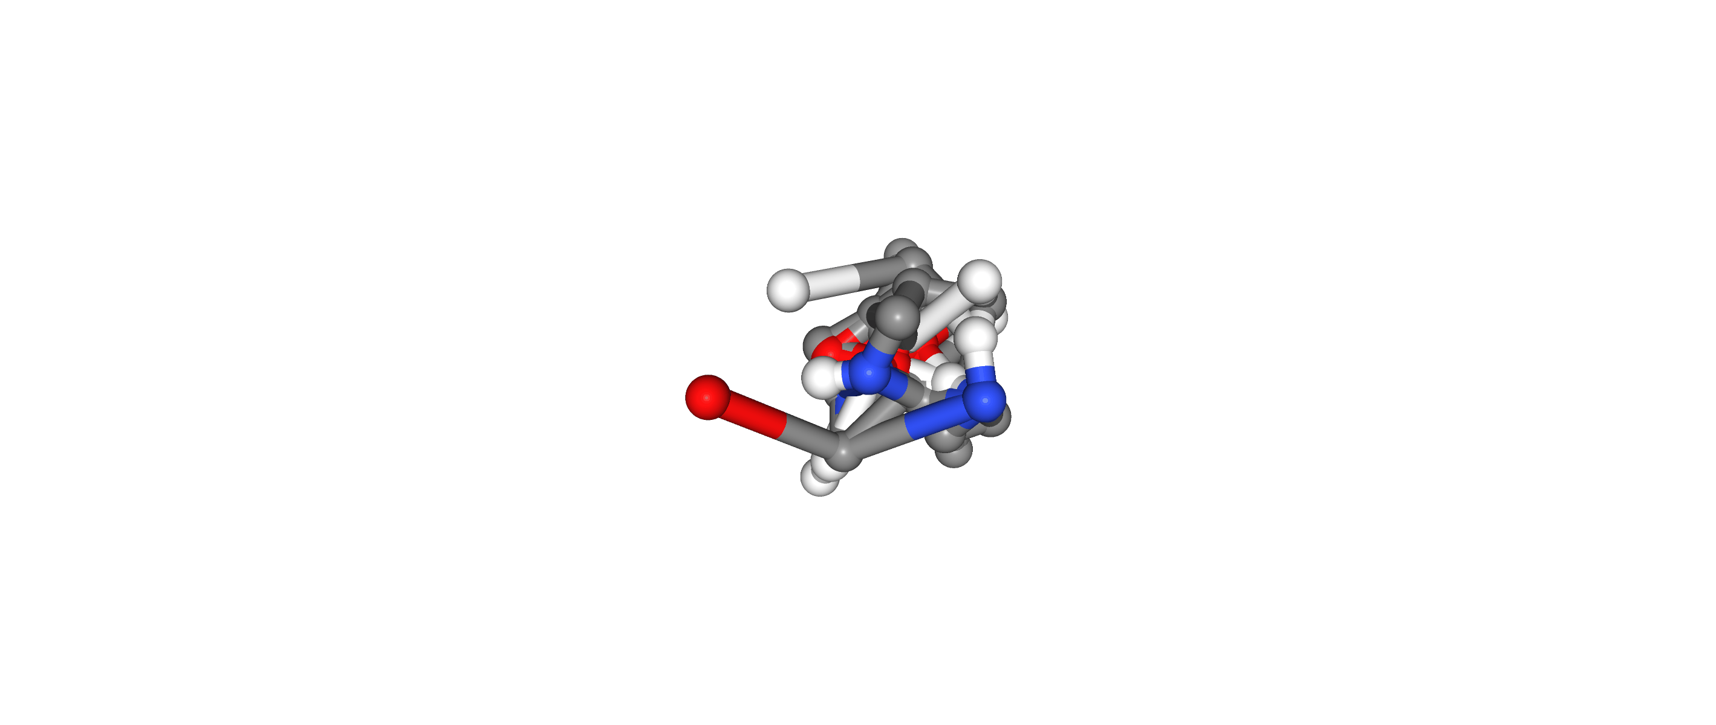
Examples

Slide 36
Summary
Great potential of AI for drug discovery
Extracting evidence from a huge amount of biomedical data
Many data in this domain are graph-structured
Small molecules, proteins, biomedical knowledge graphs
Great representation learning for drug discovery
De novo drug design
Drug repurposing
Next: moving from 2D graphs to 3D structures

Slide 37


Thanks!
PhD Students
Zhaocheng Zhu
Meng Qu
Andreea Deac
Louis-Pascal Xhonneux
Shengchao Liu
Chence Shi
Minghao Xu
Zuobai Zhang
Huiyu Cai
Farzaneh Heidari
Collaborators and previous students:, Yoshua Bengio, Jian Peng, Fei Wang, Feixiong Cheng, Pietro Lio, Connor W.Coley, Rafael Gomez-bombarelli, Fanyun Sun, Hongyu Guo, Jordan Hoffmann, Vikas Verma,….
Master Students
Minkai Xu
Jiarui Lu

Slide 38
References
Fanyun Sun, Jordan Hoffman, Vikas Verma and Jian Tang. InfoGraph: Unsupervised and Semi-supervised Graph-Level Representation Learning via Mutual Information Maximization. ICLR’20.
Chence Shi*, Minkai Xu*, Zhaocheng Zhu, Weinan Zhang, Ming Zhang, and Jian Tang. GraphAF: a Flow-based Autoregressive Model for Molecular Graph Generation. ICLR’20.
Chence Shi, Minkai Xu, Hongyu Guo, Ming Zhang and Jian Tang. A Graph to Graphs Framework for Retrosynthesis Prediction. ICML, 2020.
Minkai Xu*, Shitong Luo*, Yoshua Bengio, Jian Peng, Jian Tang. Learning Neural Generative Dynamics for Molecular Conformation Generation. ICLR’21.
Sun, Zhiqing, Zhihong Deng, Jian-Yun Nie, and Jian Tang et al. "Rotate: Knowledge graph embedding by relational rotation in complex space." ICLR’2019.
Qu, Meng, and Jian Tang. "Probabilistic logic neural networks for reasoning." Advances in Neural Information Processing Systems. 2019.
Qu, Meng*, Chen, Junkun*, Xhonneux Louis-Pascal, Bengio Yoshua, and Tang, Jian. "RNNLogic: Learning Logic Rules for Reasoning on Knowledge Graphs." ICLR’2021.
Thomas Gaudelet, Ben Day, Arian R Jamasb, Jyothish Soman, Cristian Regep, Gertrude Liu, Jeremy BR Hayter, Richard Vickers, Charles Roberts, Jian Tang, David Roblin, Tom L Blundell, Michael M Bronstein, Jake P Taylor-King. Utilising Graph Machine Learning within Drug Discovery and Development. arXiv:2012.05716, 2021
Yadi Zhou, Fei Wang, Jian Tang, Ruth Nussinov, Feixiong Cheng. Artificial intelligence in COVID-19 drug repurposing. The Lancet Digital Health, 2020

Slide 39
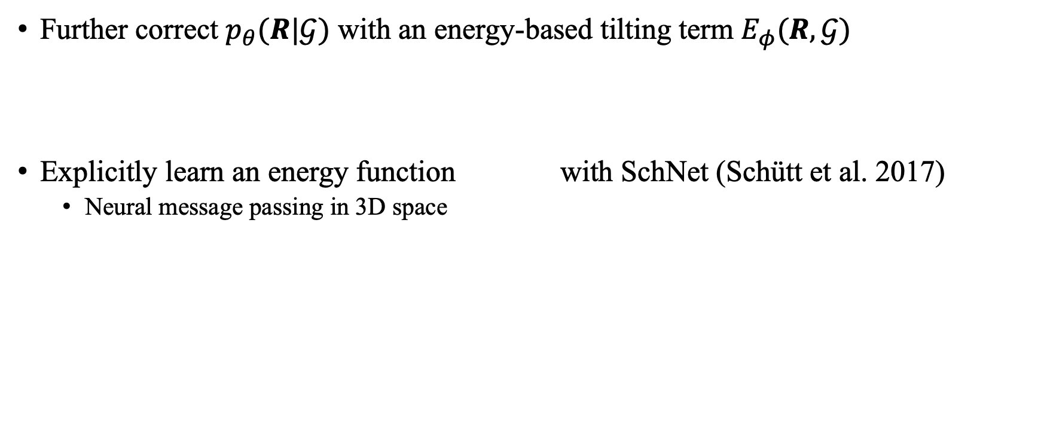
Energy-based Tilting Model
Further correct $p_{θ}(R|𝒢)$ with an energy-based tilting term $E_{φ}(R,𝒢)$
Explicitly learn an energy function with SchNet (Schütt et al. 2017)
Neural message passing in 3D space
≈
SchNet
(Schütt et al. 2017)
≈
Energy

Slide 40
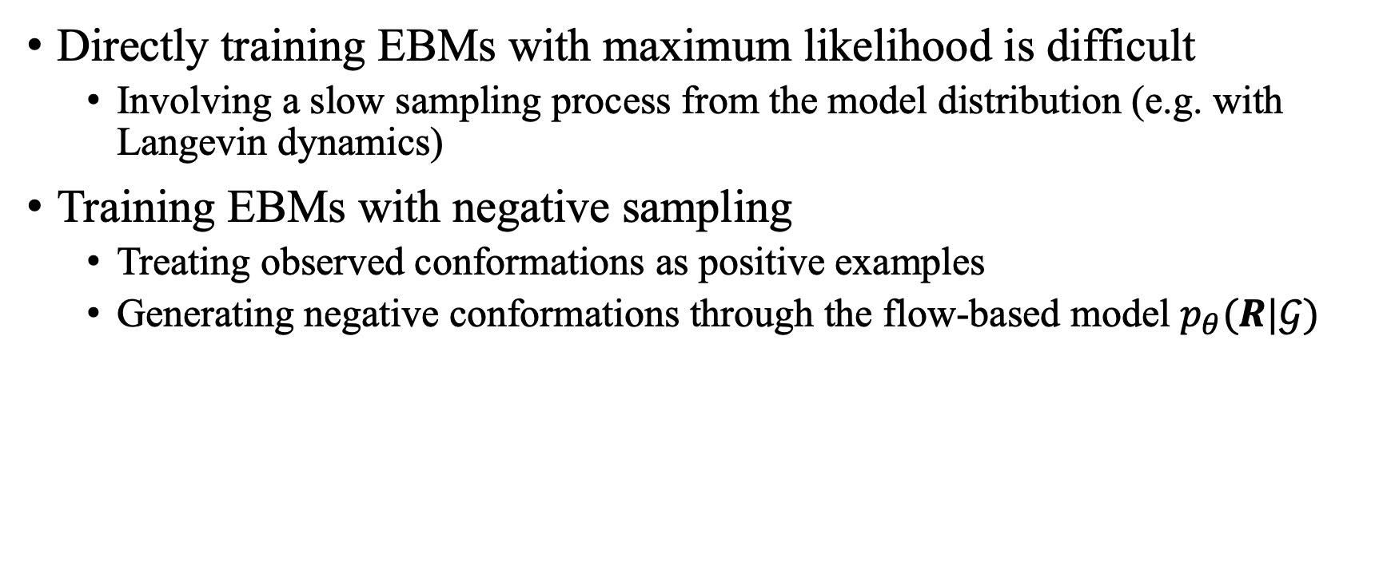
Training Energy Model
Directly training EBMs with maximum likelihood is difficult
Involving a slow sampling process from the model distribution (e.g. with Langevin dynamics)
Training EBMs with negative sampling
Treating observed conformations as positive examples
Generating negative conformations through the flow-based model $p_{θ}(R|𝒢)$

Slide 41
The Final Sampling Process:
K-steps of Langevin Dynamics

Slide 42
Reaction Center Prediction
An atom pair (i, j) is a reaction center if:
There is a bond between atom i and atom j in product
There is no bond between atom i and atom j in reactants
A supervised classification problem
Encode each edge with a graph neural network
+

Slide 43
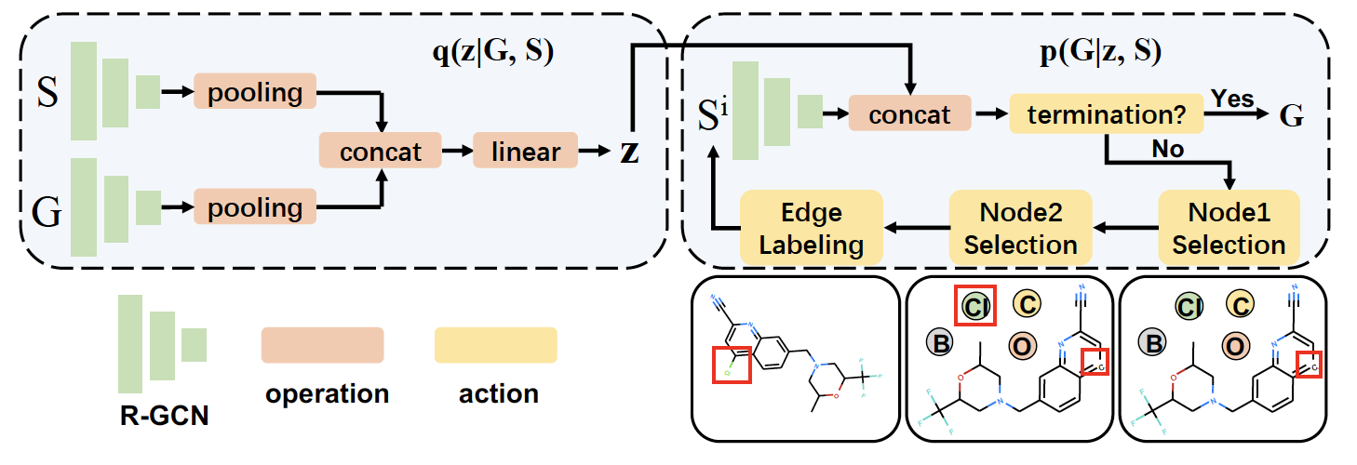
Graph Translation
Translate the incomplete synthon to the final reactant
A variational graph to graph framework
A latent variable z is introduced to capture the uncertainty during translation

Slide 44
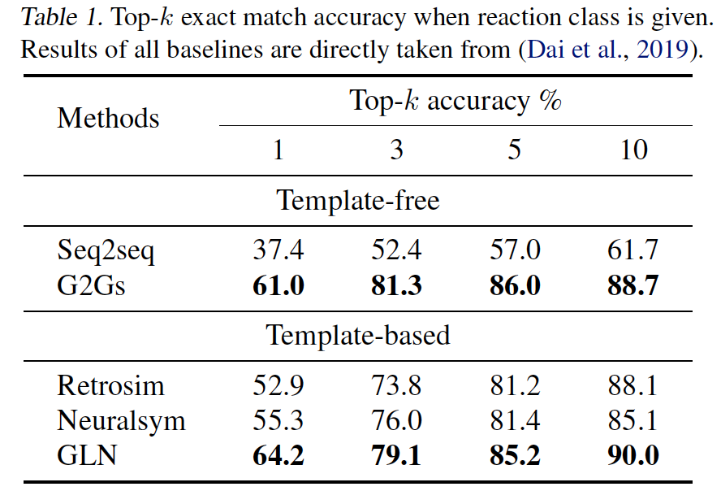
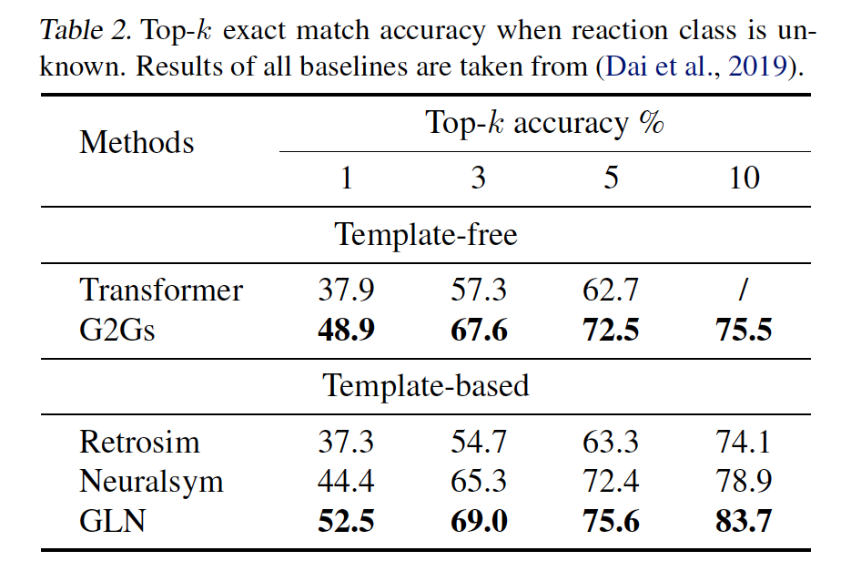
Experiments
Experiment Setup
Benchmark data set USPTO-50K, containing 50k atom-mapped reactions
Evaluation metrics: top-$k$ exact match (based on canonical SMILES) accuracy

Slide 45
Traditional Approaches
Experimental methods
Crystallography
Expensive and time consuming
Computational methods
Molecular dynamics, Markov chain Monte Carlo
Very computational expensive, especially for large molecules

Slide 46
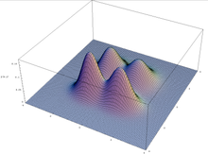
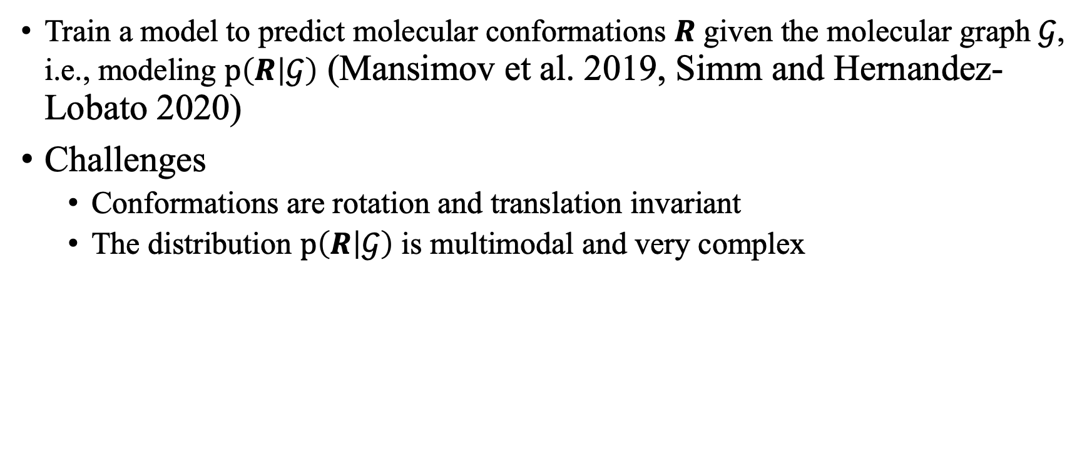
Machine Learning Approaches
Train a model to predict molecular conformations $R$ given the molecular graph $𝒢$, i.e., modeling $p\left(R | 𝒢\right)$ (Mansimov et al. 2019, Simm and Hernandez-Lobato 2020)
Challenges
Conformations are rotation and translation invariant
The distribution $p\left(R | 𝒢\right)$ is multimodal and very complex

Slide 47
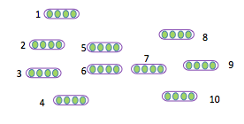
Molecule Properties Prediction
Predicting the properties of molecules or compounds is a fundamental problem in drug discovery
E.g., in the stage of virtual screening
Each molecule is represented as a graph
The fundamental problem: how to represent a whole molecule (graph)

Slide 48
Molecule Generation and Optimization
Deep generative models for data generation
Image generation
(by StyleGAN, From Internet)
Text generated by by GPT-2,
Examples from Internet
Graphs?

